Slide 1
VISUAL STUDIO CODE & JAVASCRIPT
https://github.com/tnt-summer-academy/Curriculum-2022/wiki
1h30

Slide 2
Learning objectives
TNTs will be able to navigate Visual Studio Code (VSCode).
TNTs will be able to open VSCode's Integrated Terminal in a specific folder (directory), and then type in common Linux commands (such as ls and cd)
TNTs will be able to create a new HTML & JavaScript file and run it.
TNTs will learn the basics of JavaScript.
TNTs will learn the basics of JavaScript support for functional programming, specifically those parts that are commonly used by React.

Slide 3
PART 1 GETTING STARTED
5 minutes

Slide 4
Did you install VS Code already?
Download VScode https://code.visualstudio.com/download

Slide 5

Why an IDE?
Help you work productively
http://www.howcsharp.com/47/integrated-development-environment-ide.html
Notes:
code completion, extensions, code formatting (SHIFT+OPTION+F), debugging, versioning etc.

Slide 6
Did you install npm?
Download npm https://nodejs.org/en/download/

Slide 7
npm
npm stands for Node.js Package Manager
What is node? Node.js is designed to build scalable network application. It is an asynchronous event-driven JavaScript runtime (compared to threads).
npm is
an online repository for publishing and maintaining open-source Node.js projects
a command line utility for interacting with the repo for package installation, version management, and dependency management
Packages contain files for modules. Modules are files re-used throughout an application.
React is a module
List of packages https://npmjs.com

Slide 8
PART 2 VISUAL STUDIO CODE TOUR AND HELLO WORLD
20 minutes

Slide 9
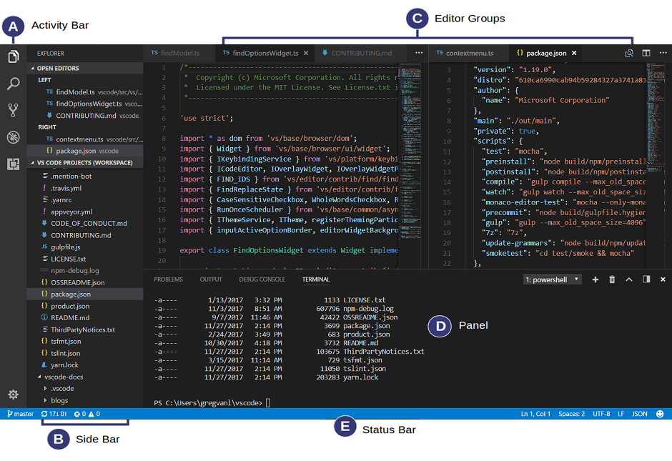
Visual Studio Code https://code.visualstudio.com

Slide 10
VS Code - Demo
Editor / Splitting editor
Minimap
Breadcrumb
Terminal (Linux)
IntelliSense – Code completion
Code Snippets - Generates pieces of code (e.g., for loop, if)
Refactoring / renaming
Formatting – OPTION + SHIFT + F
Palette – COMMAND + SHIFT + P
Activity bar
Extensions
Debugging
Source control (Git)
Code formatting with Prettier

Slide 11
PART 2 HELLO WORLD & JAVASCRIPT
10 minutes

Slide 12
Install the recommended extensions
Debugger for Chrome - To use VSCode debugger on your JavaScript code, even though it's running in your Chrome browser.
Live Share Extension Pack - To collaborate with other TNTs in VSCode just like multiple people can change the same file in Google Docs. It's awesome! Get it! Get it now! :)
Prettier - To autoformat a file when you save it
ESLint - To help find JavaScript errors and show them to you.
Open In Browser - To open an HTML file in your browser, which is useful for previewing the file that you've written
Git Graph - To show you a nice graph of branches and commits in your repos.
GitLens - More tools for interacting with git and GitHub

Slide 13
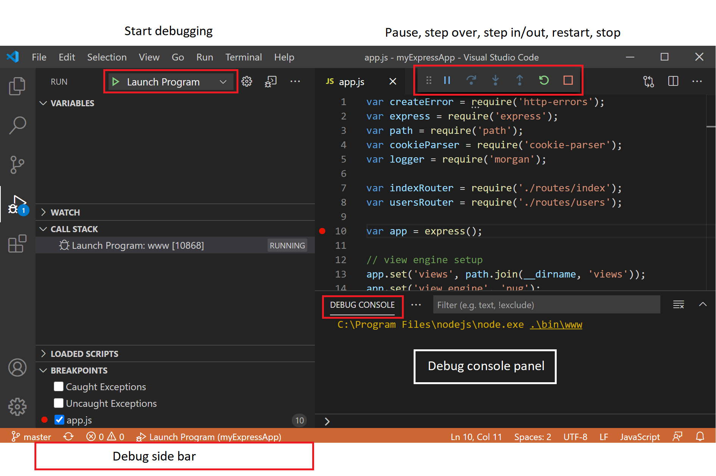

Slide 14

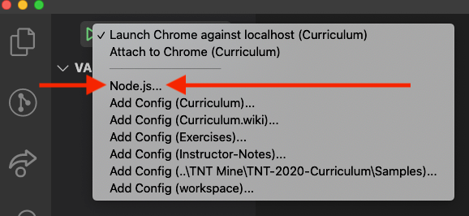
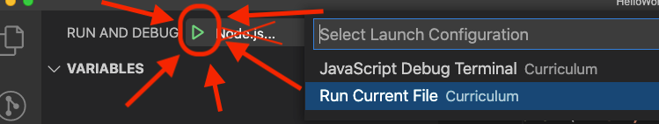
Run Helloworld.js using the VS Code Debugger
HelloWorld.js
You may have to create a file launch.json (automatically)

Slide 15
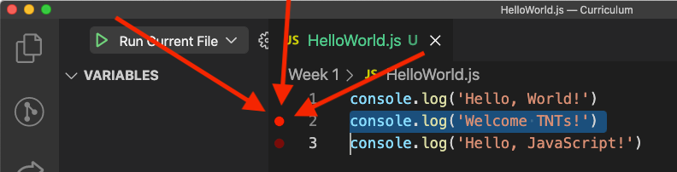
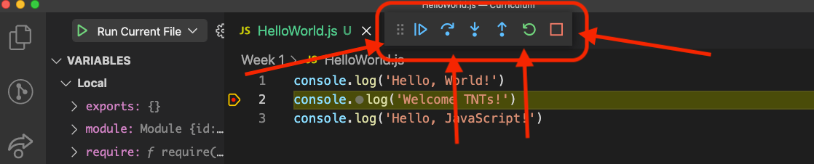
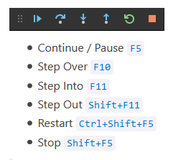
Run Helloworld.js using the VS Code Debugger - WITH BREAKPOINTS

Slide 16
PART 3 JAVASCRIPT
40 minutes

Slide 17
Open the file Intro_To_JavaScript.js
https://github.com/tnt-summer-academy/Curriculum-2022/blob/main/Week%201/%5BENG1.1%5DIntro_To_JavaScript.js
Answer the questions
// WHAT DOES THE FOLLOWING LINE PRINT, AND WHY?
Stop when you see
React-Focused Stuff Starts Here
Use the debugger and Step Over
Variables / Datatypes / Control Flows / Functions / Classes

Slide 18
Datatypes
Datatypes - what type of value can be assigned to a variable depends on the datatype
boolean for true and false statements, number, string for text, array...
We define variables with let and var
let - block scoped by {} * standard to use let nowadays
var - function scoped * still used in older code
Their values can change
We define constants with const
const - maintain the same value, cannot be updated, can only be accessed within the block it was declared

Slide 19
//Boolean - true/false
let isIceCreamCold = true;
//Number
let king = 23;
//String - can use double "" or single ' '
let color = "blue";
//Arrays index start with 0
let prime = [2, 3, 5, 7, 11, 13, 17, 19, 23];
// Constant
const nbMonth = 12;

Slide 20
console.log("Number ", king)
console.log("Number ${king}") // variable value inside a string
console.log("Number ${king*2}") // do the math inside

Slide 21
Functions
Functions are building blocks
They're used for abstraction and problem solving
Functions can be named or anonymous
Functions can have types and optional default parameters
Types define the datatypes of the variables passed into and returned from the function.
Parameters are what's passed into the function.

Slide 22
//Named function
function add(a, b){
return a + b;
}
console.log('Function add:', add(2, 3))
//Anonymous function
let added = function (x, y) { return x + y };
console.log('Function added:', added(2, 3))

Slide 23
Classes
A class in object-oriented programming languages is a template for creating objects. Classes are only available in more recent versions of JS (from 2015 onwards).
A class contains properties, constructors, and methods. Constructors are methods automatically invoked when an instance of the class is created.
In a class, this denotes that it's referring to one of the members in the class.
new is used to construct an instance of the class
JS also introduces inheritance. Inheritance extends classes
Classes inherit properties and methods from the base class
Classes will be used in React for components
Animal
IsA
Dog

Slide 24
class Animal {
move(distanceInMeters = 0) {
console.log('Animal moved ${distanceInMeters}m.');
}
}
class Dog extends Animal {
bark() {
console.log('Woof! Woof!');
}
}
const dog = new Dog();
dog.bark();
dog.move(10);
dog.bark();
Animal
IsA
Dog

Slide 25
Work in your teams up to Classes

Slide 26
PART 4 REACT-SPECIFIC JAVASCRIPT TOPICS
20 minutes
Objects / Fat Arrow Notation / Map
(around line 271 in the code)
Functional programming

Slide 27
Object literal
An object literal represents key value pairs that describe something.
For example, a rectangle has length and width.
A contact may have name, phone number and address.
let boss = {
name: "Michael Scott",
phone: "555-555-5555",
address: "Scranton, PA"
}
console.log("The world's best boss is:", boss.name, boss.phone, boss.address);

Slide 28
Reference versus Copy
Reference - creates an additional name for the same object. Changing a value in the reference object, changes the original object
Copy - creates a copy (clone) of the object. Changing the copy object will not impact the original object
//Reference of an object
let bestBoss = boss;
boss.phone = "+1555-555-555";
console.log("The world's best boss is still:", boss.name, boss.phone, boss.address)
//Copy of an object
let newBoss = { ...boss } // spread operator
newBoss.name = "Andy Bernard"
console.log("The new boss is:", newBoss.name, newBoss.phone, newBoss.address)
console.log("The world's best boss remains:", boss.name, boss.phone, boss.address)
… means “unpack all the parts of the boss object”
{ } means put everything that is in { } into the new object
Notes:
copy of state

Slide 29
Fat arrow notation
Fat arrow notation (=>) is used for anonymous functions. They are also called lambda functions
We drop the need of the function keyword and use let
This notation separates the parameters (left-hand side) from the function body (right_hand side).
If the function does not return anything, use void
let sayHi = () => {return "Hello!!!"};
equivalent to the function
function sayHi() {return "Hello!!!"};
let mult2_e = x => 2 * x;
equivalent to the function
function mult2(x){return 2*x}

Slide 30
Map
map calls a function on each element of a collection (e.g., array). Thus, it takes a function as parameter
For example, you want to add 2 to all elements of an array
// an array of strings
let myarray = ['Microsoft', 'TNTs']
// printing the array with map. map calls the function as parameters on each element of the array
console.log('Printing the array with map')
// Create a function that will print it's first parameter and ignore any others:
let printIt = (value) => console.log(value)
// print the array using map
myarray.map(printIt)

Slide 31
Another example of Map
// Multiply all elements of an array by 22
let numberarray = [1, 6, 7.5];
let mult22 = (x) => x * 22;
let newarray = numberarray.map(mult22);
console.log(newarray);

Slide 32
Filter
filter can be applied on an array based on a condition. calls a function on each element of a collection (e.g., array). Thus, it takes a function as parameter
// an array of numbers
let nums = [1, 2, 5, 6, 10, 20, 100, 200];
// Starting with the 'nums' array, create a new array that only has numbers less than 20
const smallNums = nums.filter((elt) => elt < 20);

Slide 33
Spread operator
var items = ["1", "2", "3"];
function printStuff(a, b, c) {
console.log("Printing: " + a + " " + b + " " + c);
}
// using the spread operator
printStuff(...items);
// without using the spread operator
printStuff(items[0], items[1], items[2]);
Notes:
The JavaScript spread operator ( ... ) allows us to quickly copy all or part of an existing array or object into another array or object.

Slide 34
Work in your teams on the React-related topics

Slide 35
PART 5 INTEGRATED TERMINAL
5 minutes

Slide 36
Integrated Terminal
The integrated terminal will be used for git and to build the project. It is a Linux terminal!
Use
ls -al
pwd
cd ..
In the integrated terminal

Slide 37
STRETCH

Slide 38
Stretch
Change the appearance of your terminal (more colors!) with a .zshrc file
JavaScript versus TypeScript - pros and cons
Console, terminal, shell
JavaScript Playground

